Slide 1
進度報告
Anti-spoofing

Slide 2
上次問題
Eps極小時的異常現象
時間連續性問題
filter

Slide 3
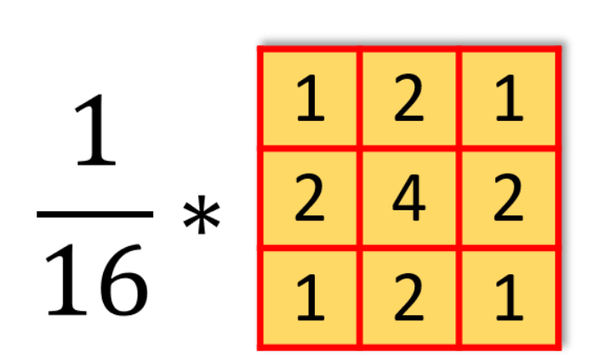

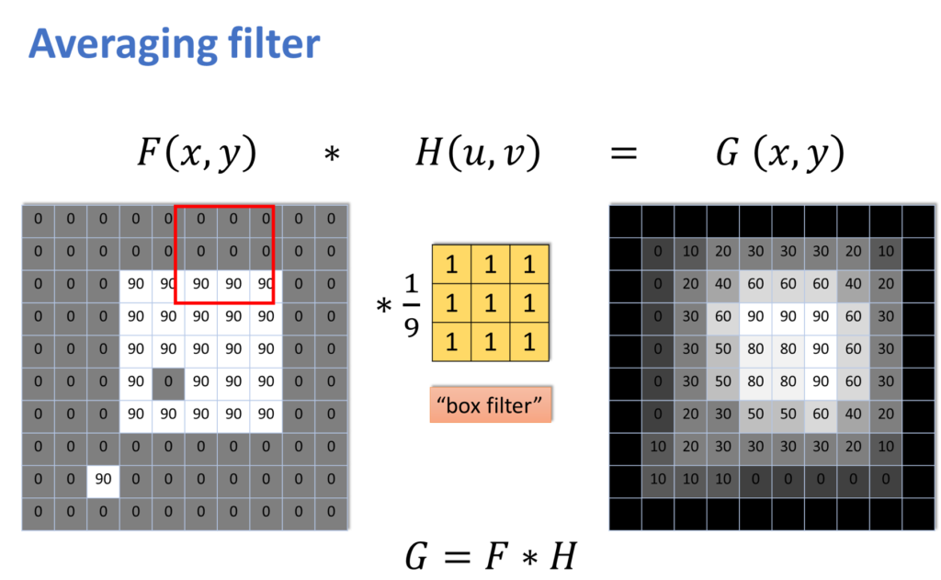
Filter intro
Gaussian filter
Uniform filter
Noise, image, all
dimension

Slide 4
OULU-1 FGSM
Filter\Epsilon | 0.3 | 0.4
No filter | 0 | 0.89
3D Uniform noise | 31.10 | 11.86
3D Uniform image | 1.34 | 0.44
3D Uniform all | 1.34 | 2.91
3D Gaussian(sigma=1) noise | 60.85 | 56.38
3D Gaussian(sigma=1) image | 12.08 | 20.36
3D Gaussian(sigma=1) all | 8.50 | 9.17
3D Gaussian(sigma=0.5) noise | 0 | 0
3D Gaussian(sigma=2) noise | 37.81 | 41.16
3D Gaussian(sigma=2) image | 12.75 | 16.33
2D Uniform noise | 0.22 | 0
2D Uniform image | 0 | 0
2D Uniform all
2D Gaussian(sigma=1) noise | 0.22 | 0
2D Gaussian(sigma=1) image | 0 | 0
2D Gaussian(sigma=1) all | 1.34
Model
Attack
acc_mean | apcer | bpcer | acer
95.91 | 15.12 | 1.28 | 8.20

Slide 5
OULU-1 iFGSM
Filter\Epsilon | 0.3 | 0.4
No filter | 46.98 | 49.44
3D Uniform noise | 6.26 | 11.86
3D Uniform image | 0 | 0
3D Uniform all | 2.91 | 2.91
3D Gaussian(sigma=1) noise | 6.26 | 13.42
3D Gaussian(sigma=1) image | 2.01 | 2.24
3D Gaussian(sigma=1) all | 2.91 | 4.03
2D Uniform noise | 16.78 | 22.37
2D Uniform image | 11.19 | 18.12
2D Uniform all
2D Gaussian(sigma=1) noise | 11.41 | 17.67
2D Gaussian(sigma=1) image | 4.7 | 16.55
2D Gaussian(sigma=1) all | 0.89 | 8.05
Model
Attack
acc_mean | apcer | bpcer | acer
95.91 | 15.12 | 1.28 | 8.20

Slide 6
OULU-2 FGSM
Filter\Epsilon | 0.3 | 0.4
No filter | 0 | 4.23
3D Uniform noise | 11.03 | 4.83
3D Uniform image | 4.23 | 4.08
3D Uniform all | 1.21 | 4.83
3D Gaussian(sigma=1) noise | 2.57 | 6.34
3D Gaussian(sigma=1) image | 9.97 | 19.94
3D Gaussian(sigma=1) all | 3.32 | 7.85
2D Uniform noise | 0 | 0
2D Uniform image | 0.15 | 0.45
2D Uniform all | 0.15 | 0.15
2D Gaussian(sigma=1) noise | 0 | 0
2D Gaussian(sigma=1) image | 0.15 | 0.3
2D Gaussian(sigma=1) all | 0.15
Model
Attack
acc_mean | apcer | bpcer | acer
94.30 | 2.79 | 7.15 | 4.97

Slide 7
OULU-2 iFGSM
Filter\Epsilon | 0.3 | 0.4
No filter | 69.03 | 75.83
3D Uniform noise | 14.65 | 21.60
3D Uniform image | 8.61
3D Uniform all | 12.24 | 18.43
3D Gaussian(sigma=1) noise | 14.80 | 21.60
3D Gaussian(sigma=1) image | 18.28 | 21.60
3D Gaussian(sigma=1) all | 19.64 | 30.06
2D Uniform noise
2D Uniform image
2D Uniform all
2D Gaussian(sigma=1) noise | 20.24 | 31.27
2D Gaussian(sigma=1) image | 16.62 | 29.15
2D Gaussian(sigma=1) all | 6.95 | 23.26
Model
Attack
acc_mean | apcer | bpcer | acer
94.30 | 2.79 | 7.15 | 4.97

Slide 8
image

Slide 9
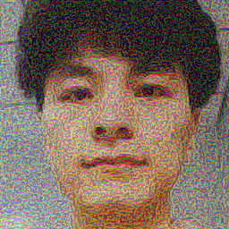
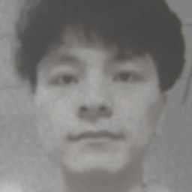
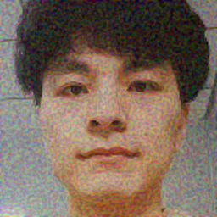

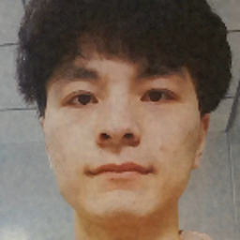
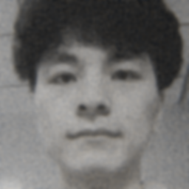


OULU-1 FGSM GAUSSIAN
No filter
3D Sigma = 1 all
2D Sigma = 1 noise
2D Sigma = 1 image
Eps = 0.3
0
8.5
0.22
0
3D Sigma = 2 noise
3D Sigma = 2 image
3D Sigma = 0.5 noise
2D Sigma = 1 all
37.81
12.75
0
1.34

Slide 10
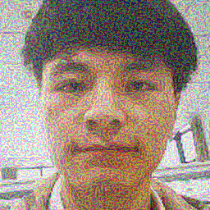

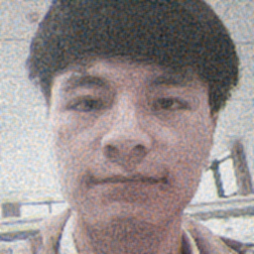





OULU-2 FGSM UNIFORM
No filter
noise
image
all
Eps = 0.3
0
11.03
4.23
1.21
Eps = 0.4
4.23
4.83
4.08
4.83

Slide 11
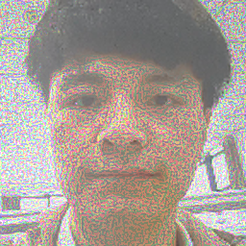
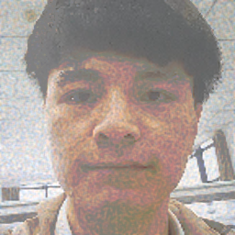


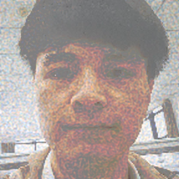

OULU-2 iFGSM UNIFORM
No filter
noise
image
Eps = 0.3
69.03
14.65
8.61
Eps = 0.4
75.83
21.60

Slide 12




OULU-2 iFGSM GAUSSIAN
No filter
noise
image
all
Eps = 0.3
69.03
18.28
19.64
Eps = 0.4
75.83
21.60
30.06

Slide 13
觀察
filter應用在FGSM的效果較顯著
Performance：Gaussian > Uniform
filter應用導致iFGSM的效果變差

Slide 14
下次進度
調整最適合的sigma
跑完實驗
SSIM
找其他filter
Demo system

